Slide 1

Get Grounded
Bella Pao, Brett Perez, Esther San Diego, and Leonardo LaPorta
Notes:
April 22: You will be presenting your Alone Time Prototypes this week in your Recitation. You will need to turn in three things:
a link to your Adobe XD prototype
a PDF containing documentation of your process
a link to your Google Slides presentation.
Your slides must use the template
(Links to an external site.)
provided.
To save time everyone will present from my computer, so test your link in advance.
You will have around 5 minutes to present.
You can choose one person from your group to present, or you can all present, it is up to you.

Slide 2
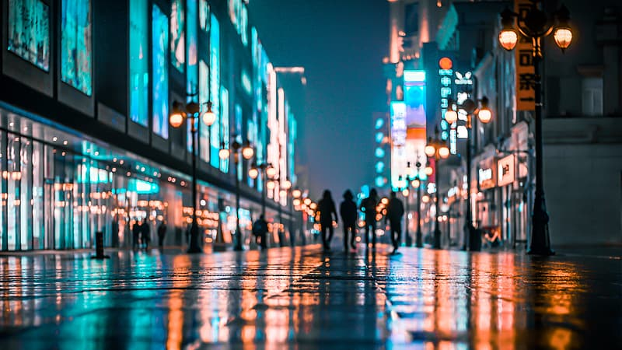
Empathy Stage and POV
We noticed that people don’t utilize alone time to process themselves and feelings.
POV Statement:
People turn to their phone when bored and lonely instead of processing emotions, thoughts, or reflecting on themselves.
There is societal pressure to turn to the phone when waiting in line to look more connected to other people digitally or to seem productive.
Notes:
1 min

Slide 3
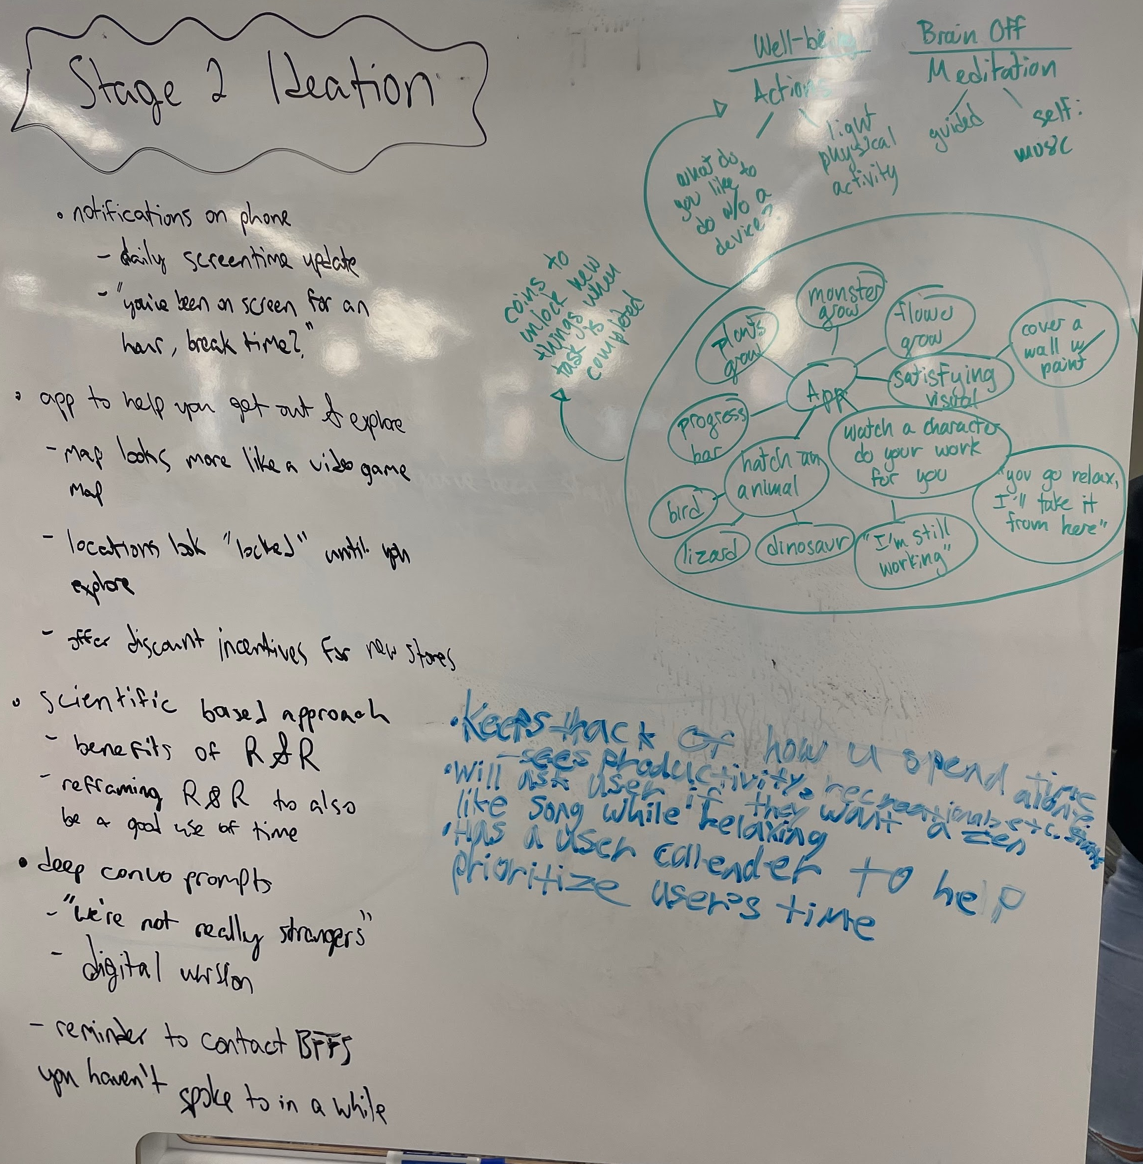
Brainstorming and Ideation
Idea
Description
Problem?
Set a task, grow a plant
Don’t want to demonize phones
Flower App
Lock phone, unlock after walking 1 mile
Walk App
Not Interactive
Answer prompts, dig deeper
We like this one :)
Journaling
Notes:
1 min

Slide 4

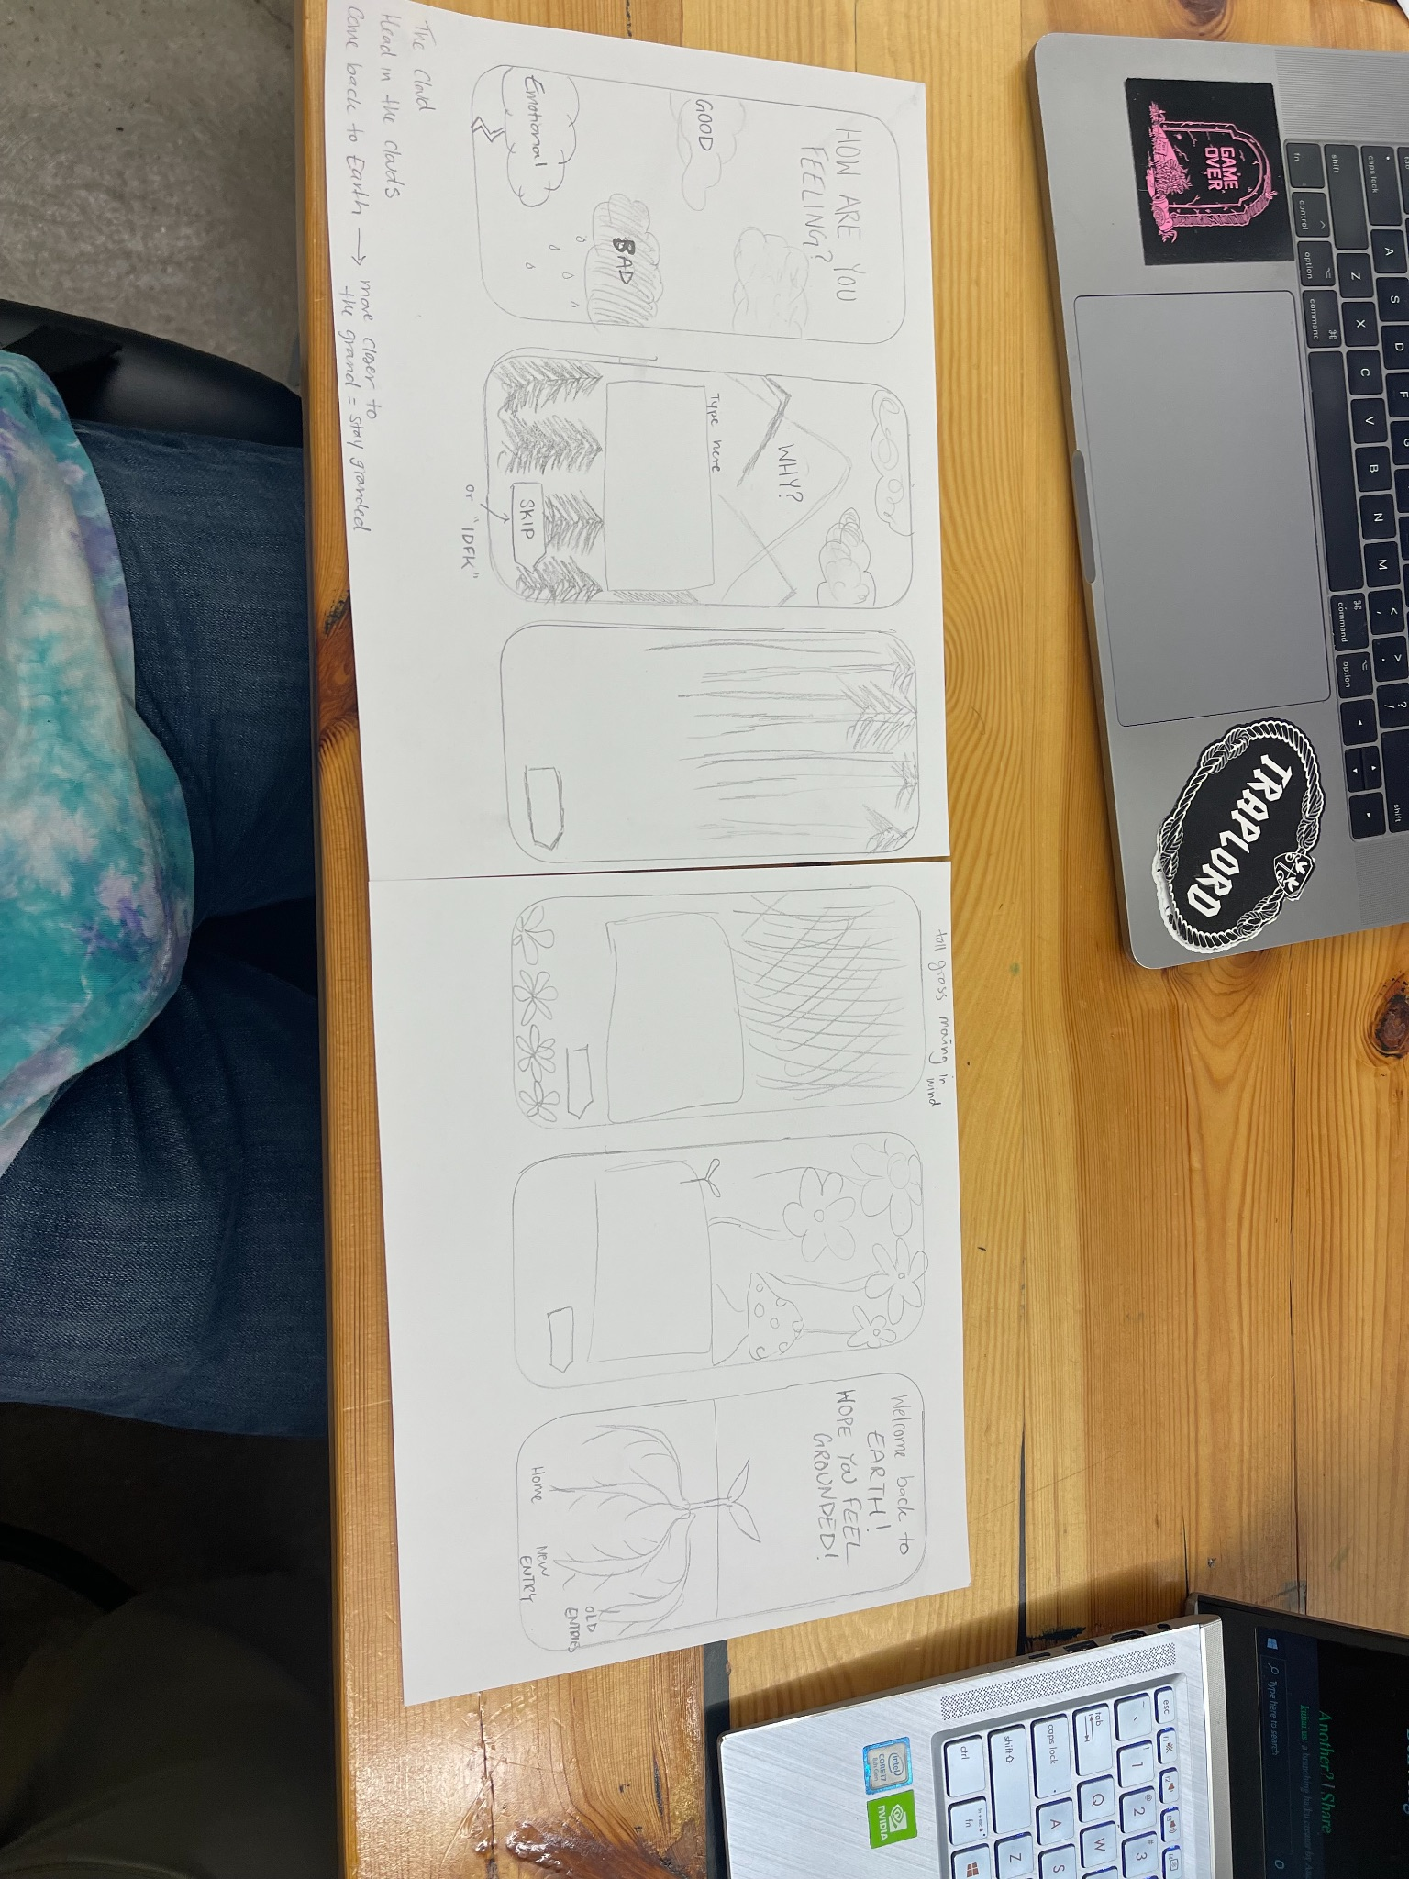
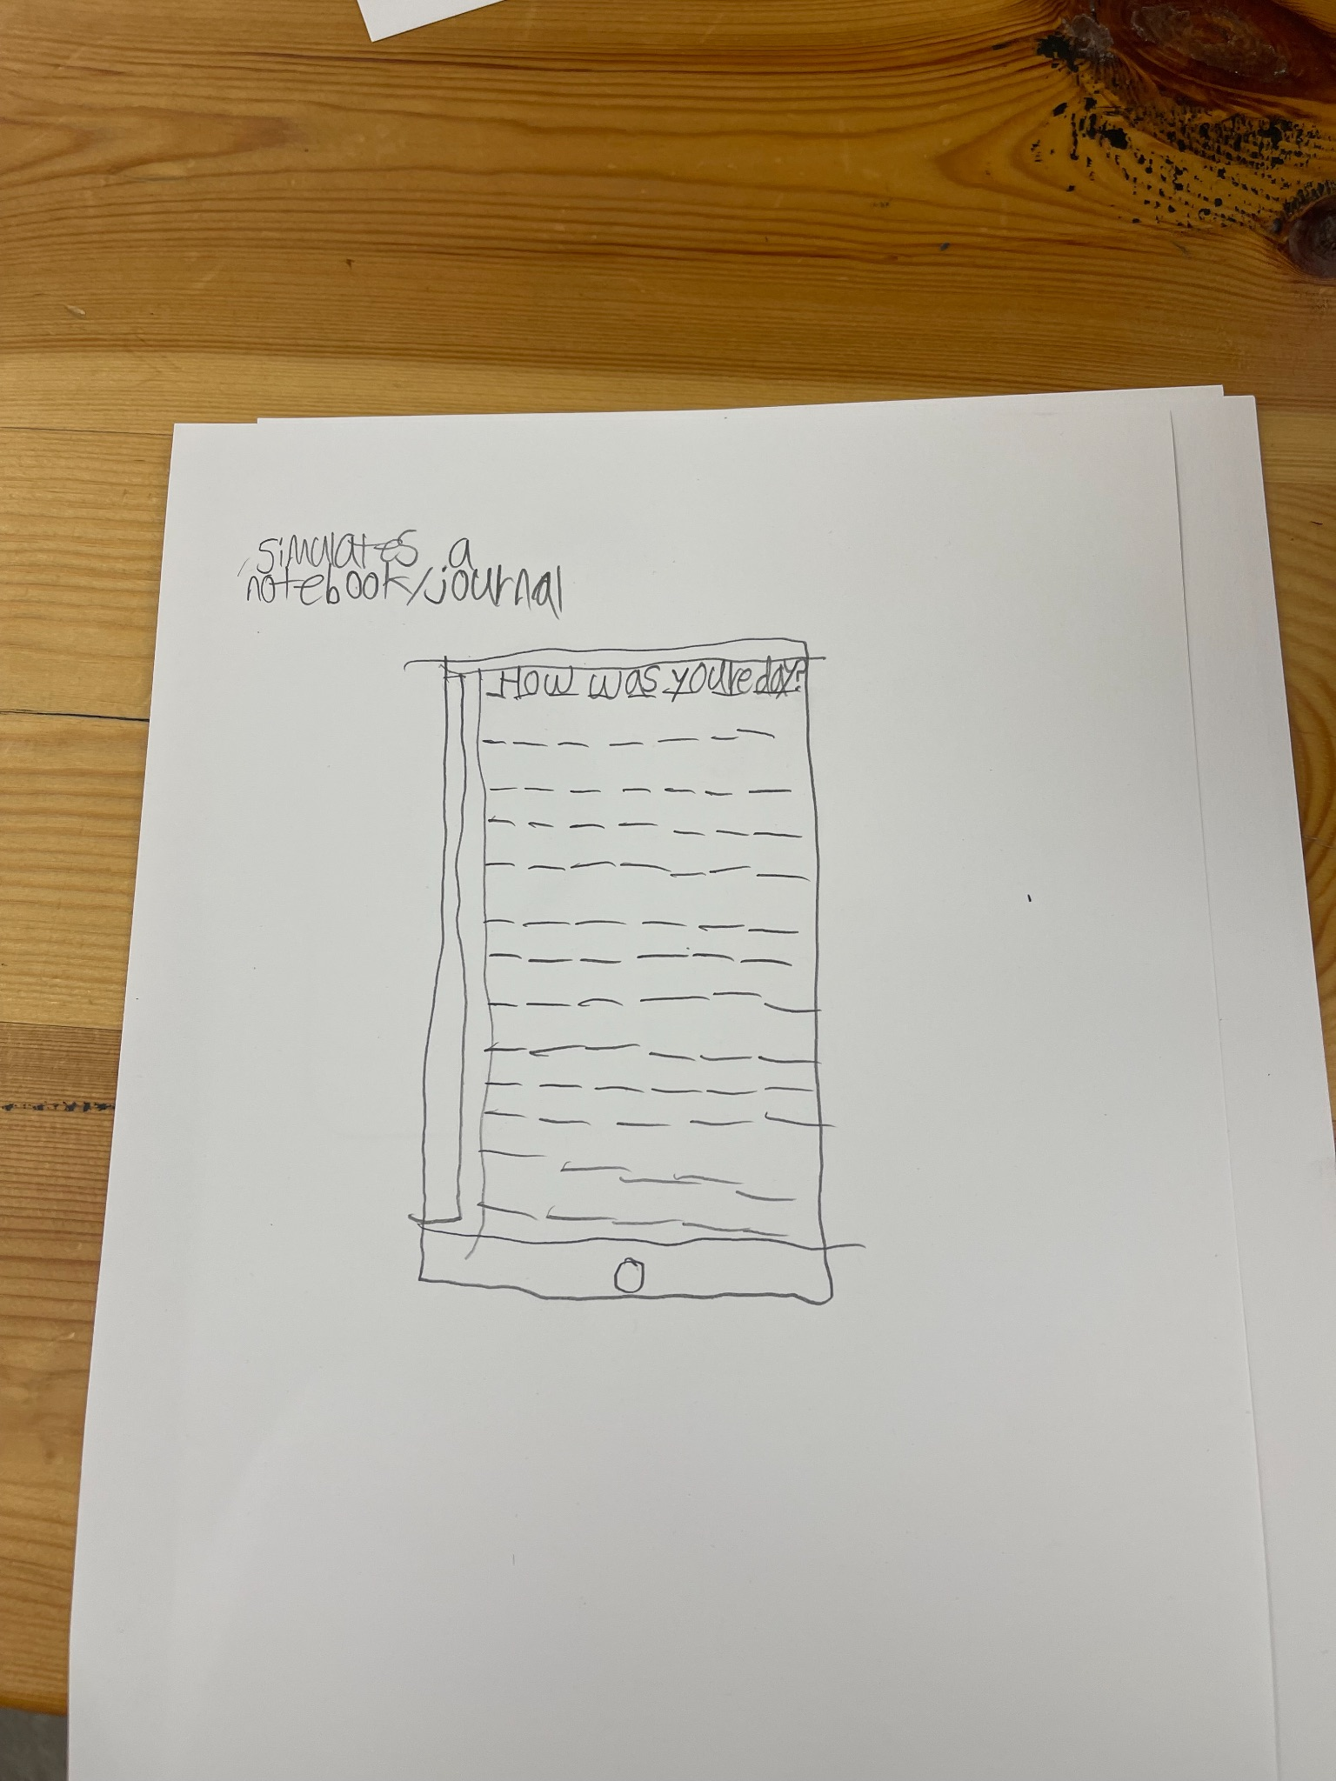
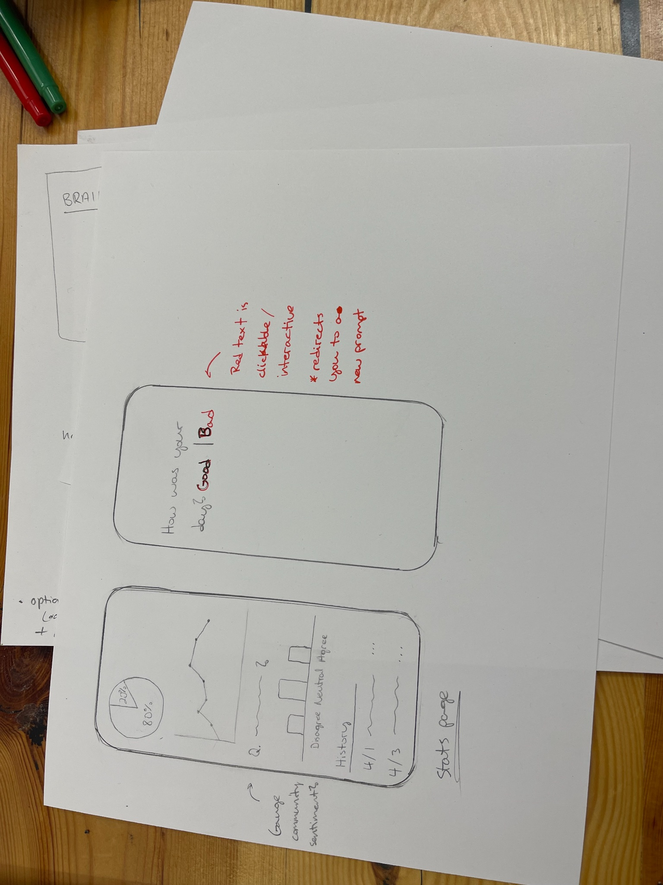
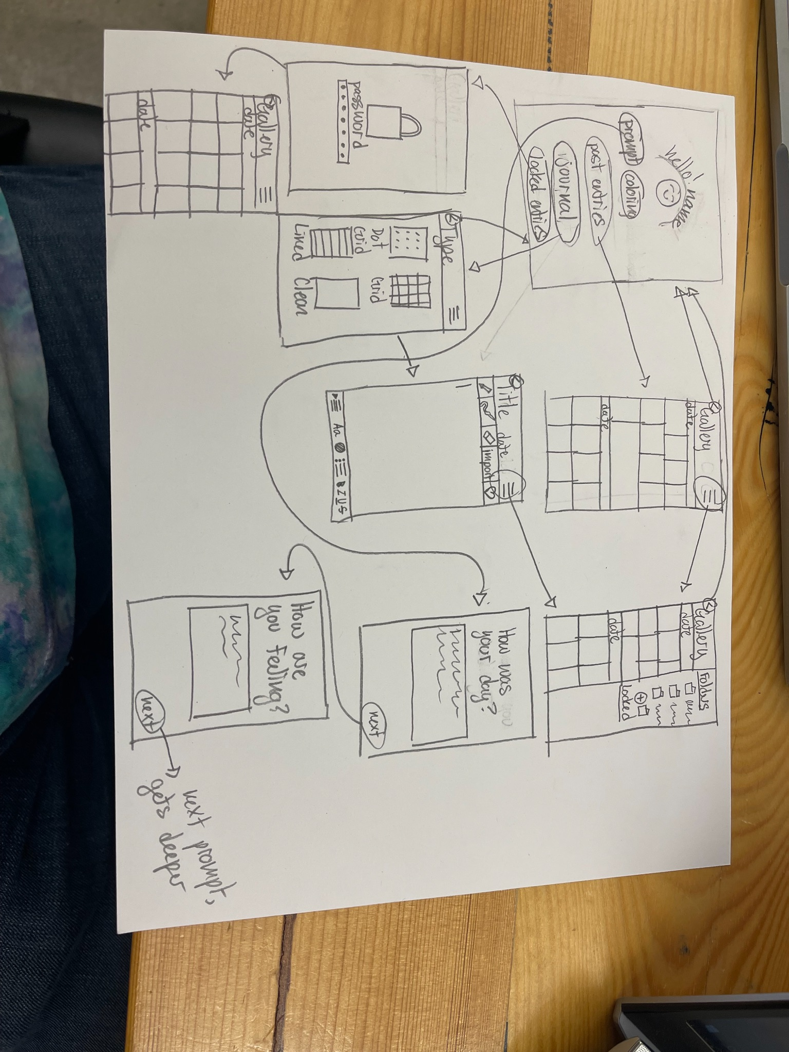
Prototyping
Notes:
1 min total

Slide 5
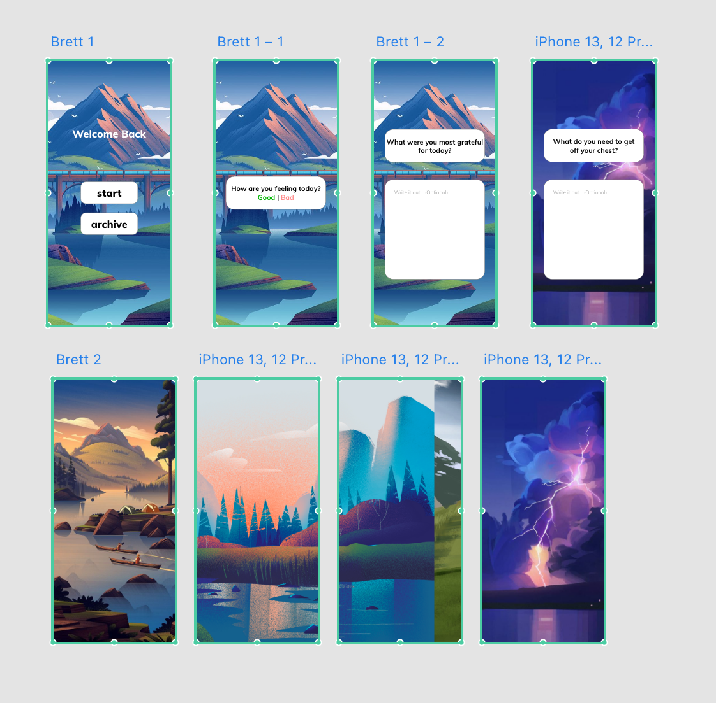
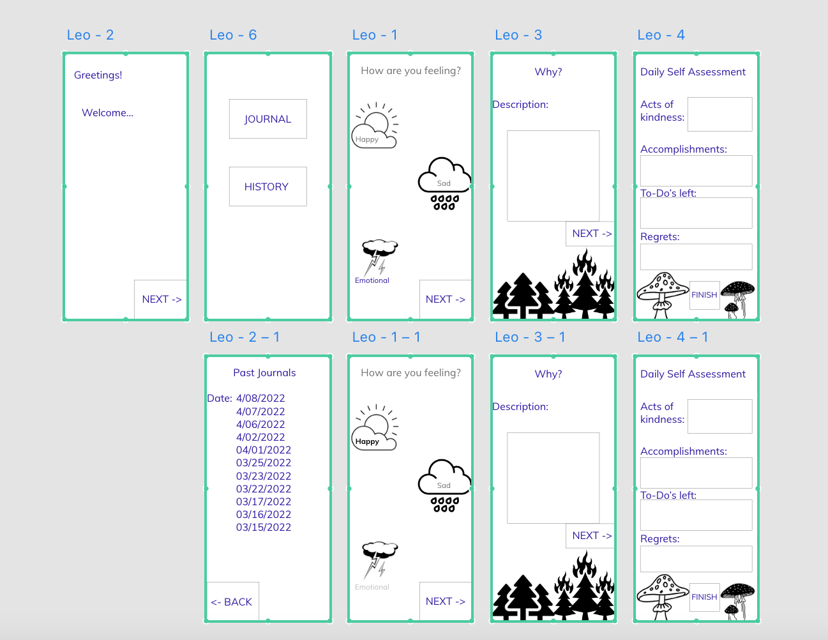
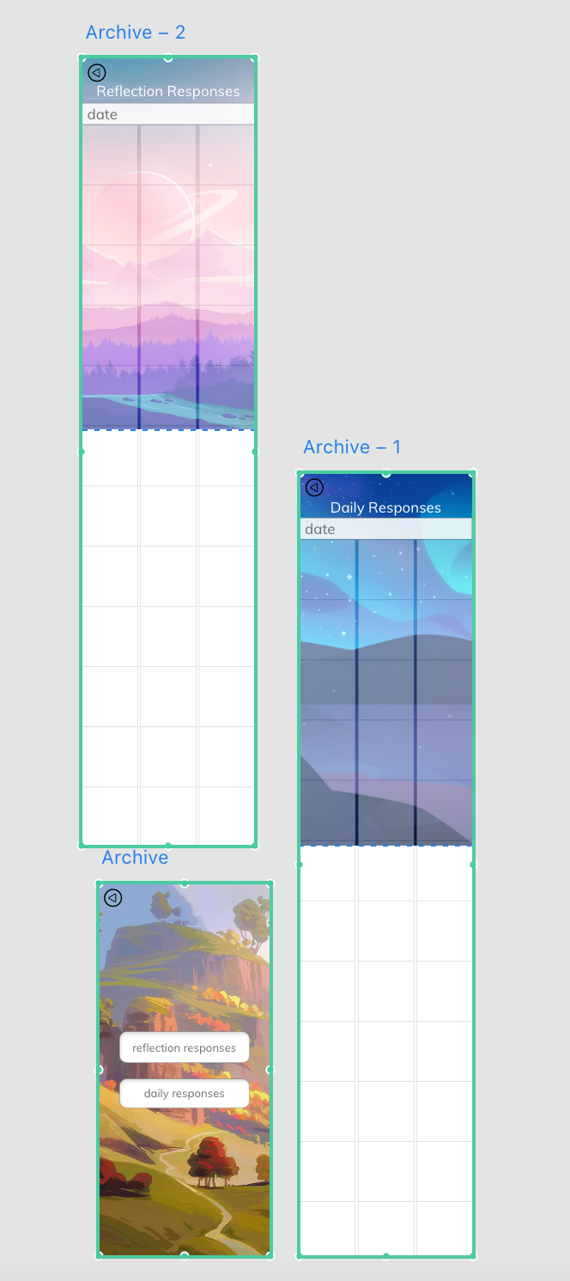
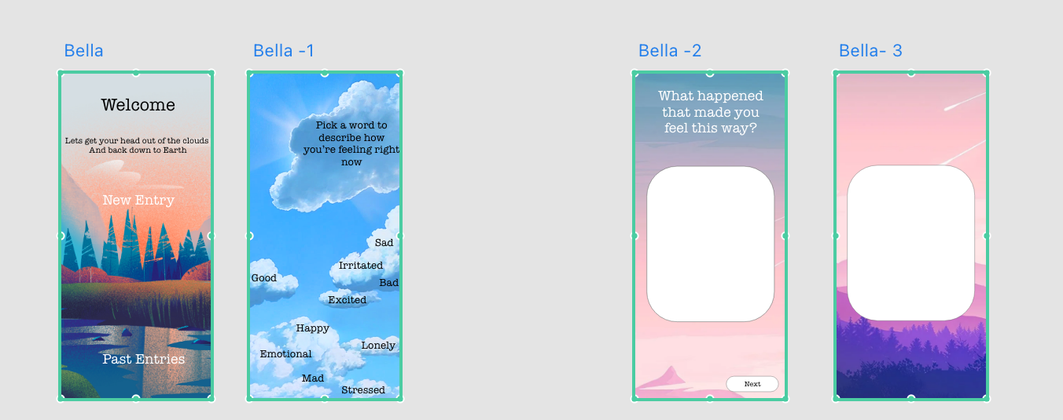
Prototypes

Slide 6

Final Design
https://xd.adobe.com/view/b4b22eb2-8e5a-4072-98a6-ce5f8d3a15a8-e1e1/
Get Grounded
Notes:
2 min

Slide 7
Thank You!
Notes:
Critique

